Slide 1
Artist statement
My artistic expressions are rooted in my scientific projects and training. My research focuses on water pollution, including studies on chemicals, urbanization, and anthropogenic litter (trash like plastic, glass, and metal). Well studied in the ocean, research on the ecological dynamics of anthropogenic litter in freshwaters is uncommon. My students and I measure the abundance, sources, movement, and biological interactions of litter in rivers and the Great Lakes. During the course of this work, we have found litter that is fascinating to examine. I’ve kept much of this material to create sculptures which I attach to painted canvases. My artwork has 3 objectives:
Longevity. This litter is one part of the permanent human imprint on the geologic record, an emerging concept tentatively called the “Anthropocene Era”. To make this connection, I wire the litter onto the frames of canvases where I have painted abstractions of geologic layers or satellite images.
Data. I paired many pieces with a graph that indicates where the material was found, and shows some results we generated from that item. I hope the graph is itself compelling to look at, but also demonstrates that these items are data generated from a systematic, scientific assessment.
Look closely. I hope to convey to onlookers that the rusting and fragmentation of material in the environment generates compelling shapes. The dynamic nature of the surfaces can be easily overlooked. By placing the items in a new context, viewers examine the details of litter. The cracks, algae, rust, rocks, and continuous breakdown bring it alive.
This artwork is a complementary and logical extension of my scientific research. Thinking mathematically and creatively supports both lines of work. It is my hope the combination will expand the audience that receives the message of the research and carries the ideas forward in a new way.
Timothy Hoellein, Ph.D.
thoellein@luc.edu
tim.hoellein@gmail.com
Google Scholar
(link to research)

Slide 2
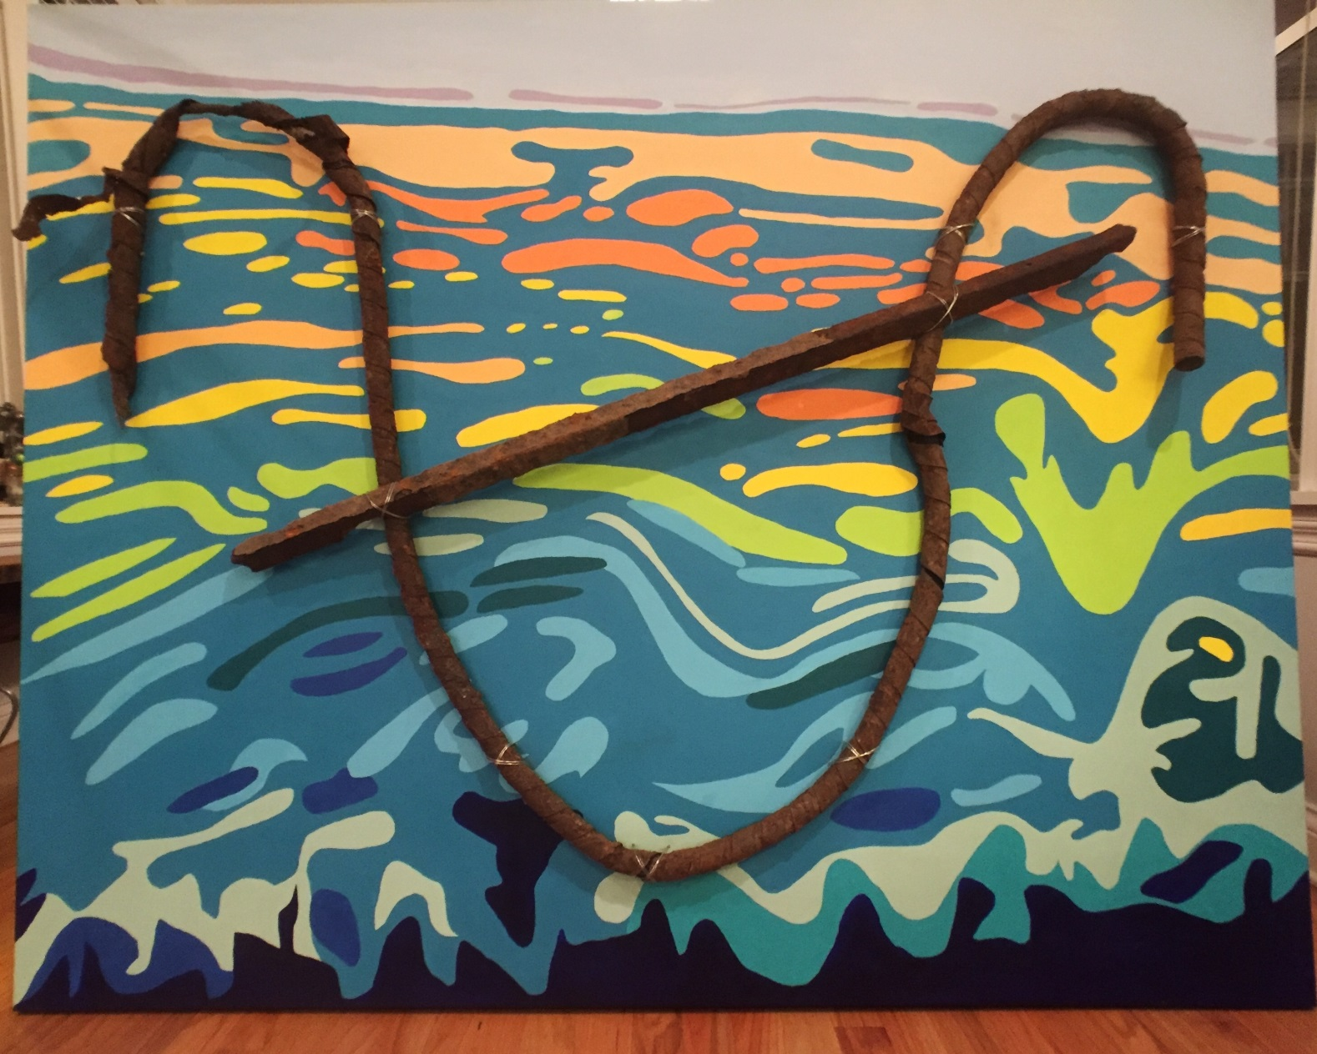
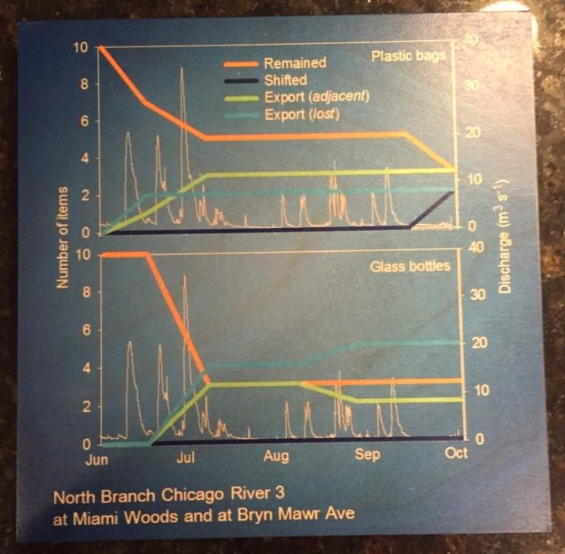
Title card and graphs, ink on wood (8 in x 8 in)
Acrylic on canvas, with attached low relief metal and wire sculpture (4 ft x 5 ft)
The canvas shows my abstraction an image illustrating layers in a Greenland glacier. The freezing and melting of water above and below the glacier generates hidden strata only recently illustrated by ground-penetrating radar. The data from the image convey the glacier’s slow downstream movement and changes in shape over very long time scales. The metal pieces represent human impacts which have left an indelible record in the ice, becoming preserved, moved and re-shaped through interaction with geologic processes.
The graph shows how litter items move through a river, some become entrenched, some moving nearby, and some lost altogether. Our litter ‘footprint’ extends in all directions and will long outlive us, echoing the statement in the canvas and metal sculpture.

Slide 3
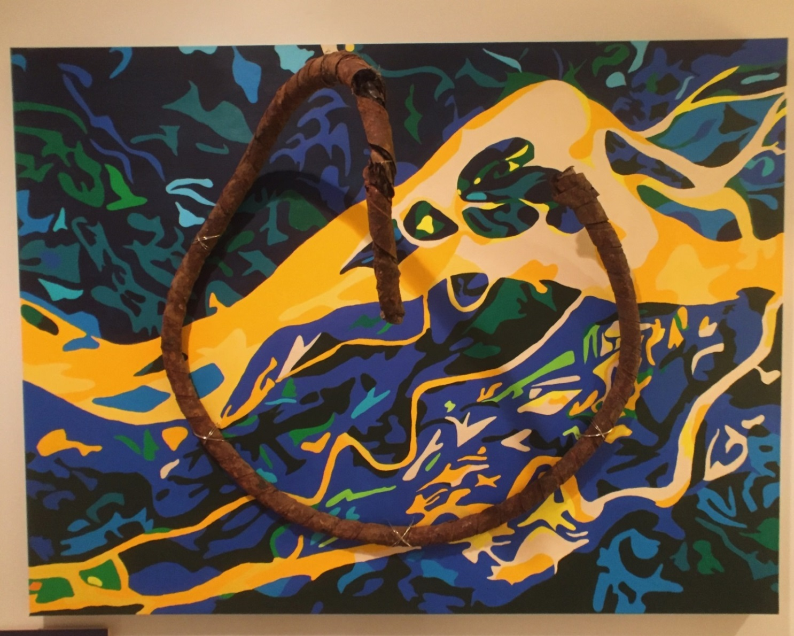
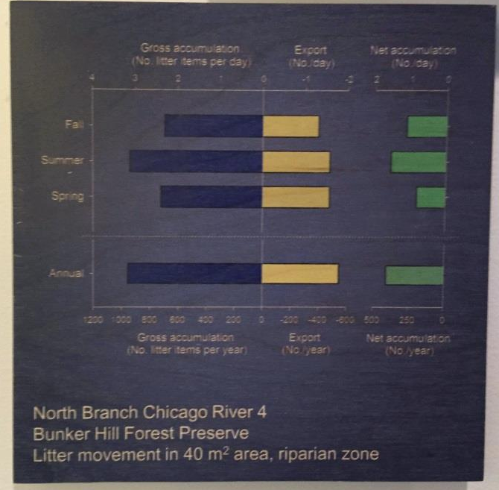
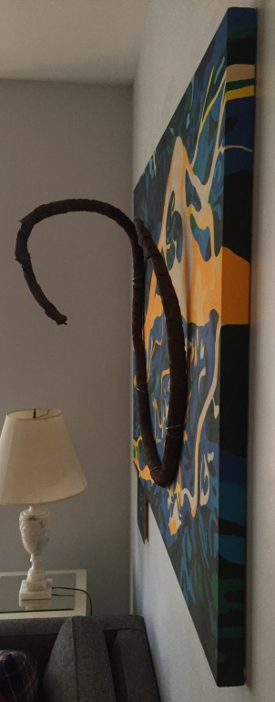
Title card and graphs, ink on wood (8 in x 8 in)
Acrylic on canvas, with attached metal and wire sculpture (3 ft x 4 ft x 1 ft)
The subject of the painting is my abstraction of a satellite picture of the Parana River in South America. The image conveys the complexity of a lowland river channel in its natural state. The braided channel is always in motion, forming and re-forming its connections to ponds and side channels as it makes its way to the ocean. The combination of constancy and change illustrated by rivers is one part of what draws people to them. I’ve added a metal piece which extends out from the canvas in a circular shape similar to a serpent. The fluid, 3-dimensionality of the sculpture represents how human impacts on the river have been incorporated into the permanence (i.e., constancy) of the river, but are also subject to continuous re-formation through its dynamic movement.
The graph is a summary of how litter moves in a river. We recorded new inputs and losses by season and for 1 year. Like the painting and sculpture, these data show the continuous deposition, partial storage, and constant loss of litter as it interacts with the natural processes of the fluvial landscape.
Side view to illustrate relief

Slide 4
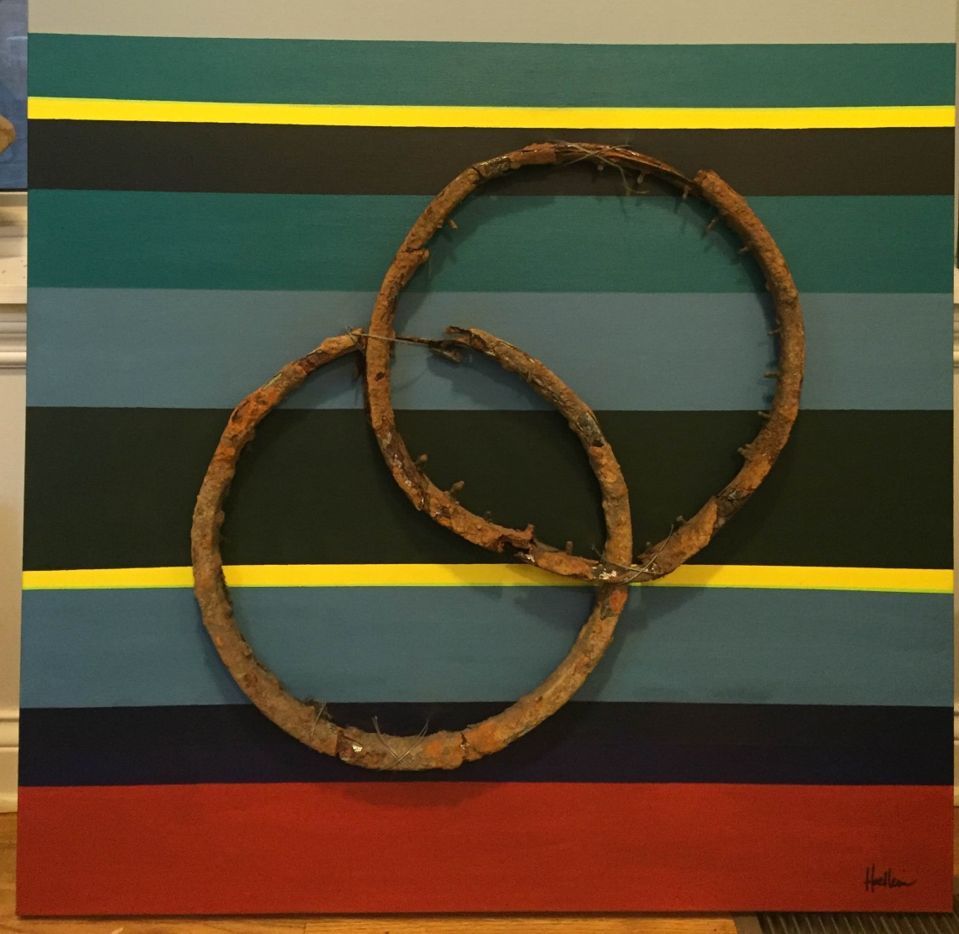
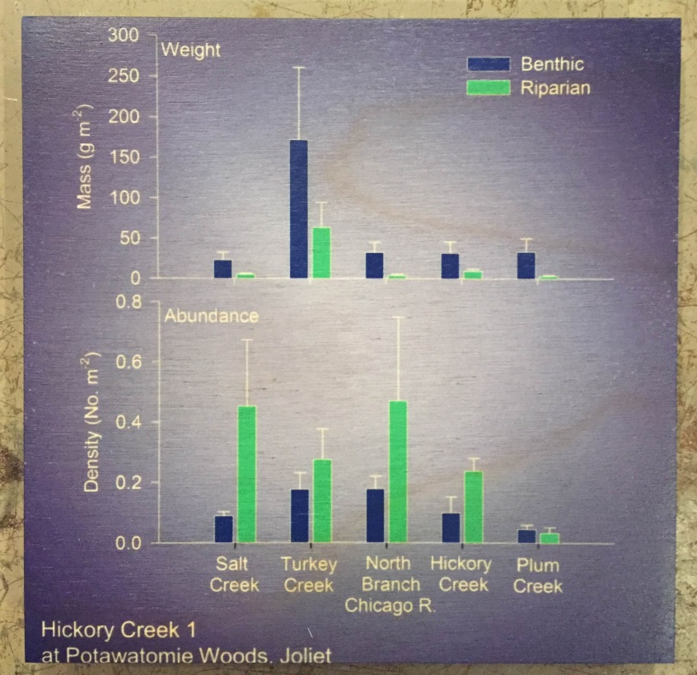
Title card and graphs, ink on wood (6 in x 6 in)
Acrylic on canvas, with attached metal sculpture (3 ft x 3 ft)
The combination of linked ecosystems is the subject of this piece. As in other my works, horizontal strata refer to preservation of natural and anthropogenic material in the geological record. The two rusted circles are bike wheels. The fragile wheels are intertwined using steel wire. The connection between the two shapes refer to the benthic and riparian zones of our study sites. The riparian zone is streamside vegetation, and the benthic zone is the streambed. We find that anthropogenic litter moves between benthic and riparian habitats as it is suspended, moved, and re-deposited during flooding. The aquatic and terrestrial components of the stream habitats are naturally interconnected, and thereby also store and reanimate litter we introduce into them.
The graph is a summary of the density and mass of litter we find in both habitats in a number of streams around Chicago. The two distinct, yet combined habitats in the paired bars are a reference to the intertwined bike wheels.

Slide 5
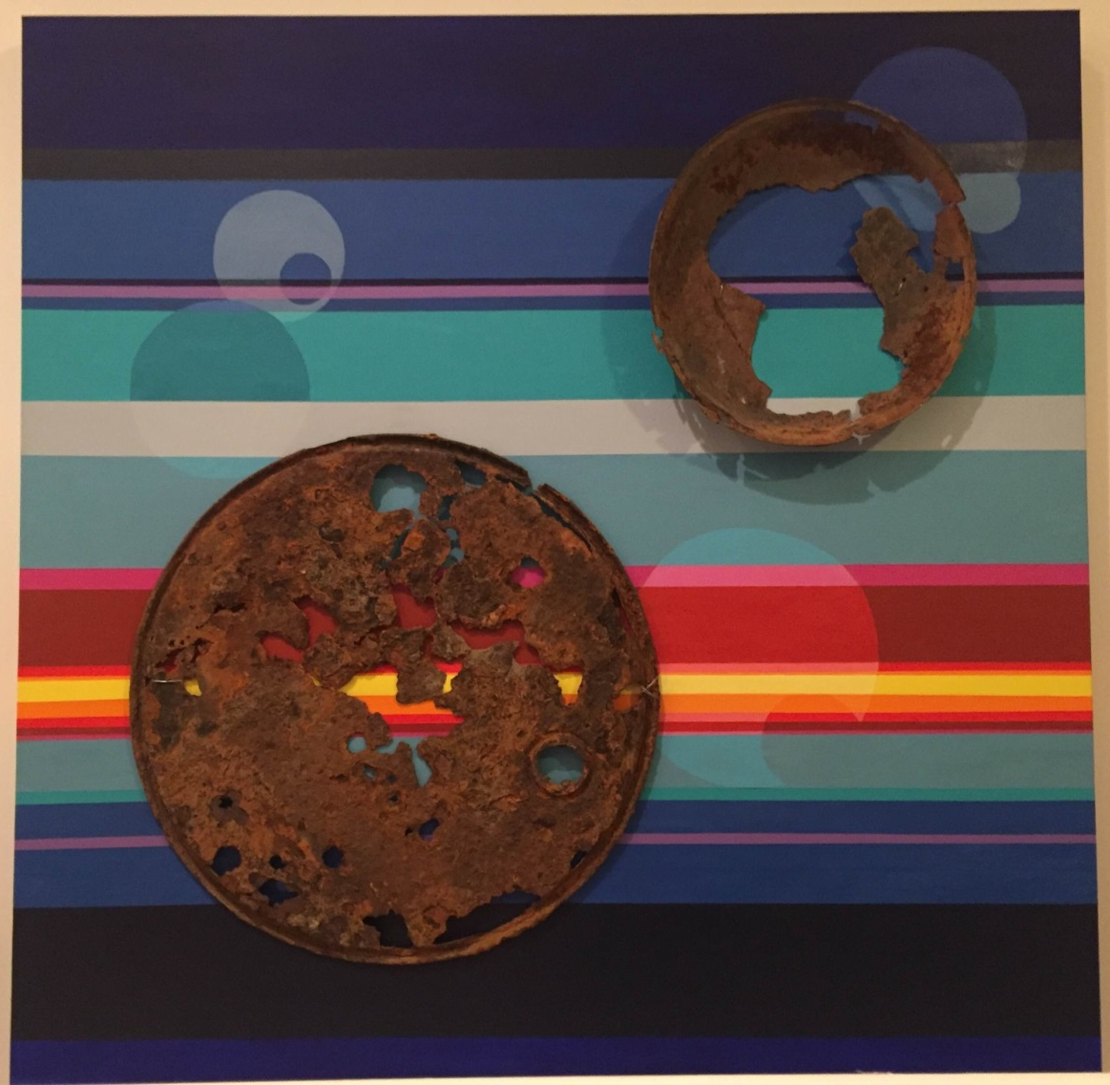
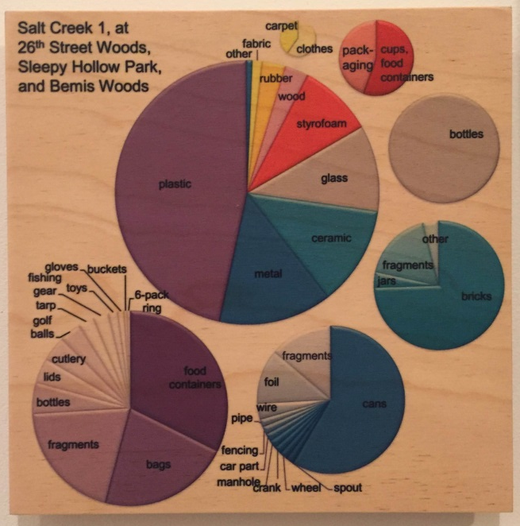
Title card and graphs, ink on wood (8 in x 8 in)
Acrylic on canvas, with attached low relief metal and wire sculpture (4 ft x 4 ft)
This image combines abstractions of geologic and astronomic motifs. The horizontal layers are my allusion to geologic strata, representing long-term deposition of natural material and litter in the Earth. The intricate rusting of the manhole cover and metal bowl also convey the appearance of weathered planetary surfaces. I painted additional spheres in the horizontal stripes as echoes of past materials that although they have entirely rusted away, their imprints in the record remain. I like that these additional spheres suggest a dynamic interplanetary system. The composite image is meant to reinforce the longevity of litter impact in the Earth’s geological record.
The graph is a summary of all the types of litter we found at the site where these two items were located, Salt Creek, just west of Chicago, IL. The nested pie graphs refer back to the planetary shapes of the litter items and use a similar color palette.

Slide 6
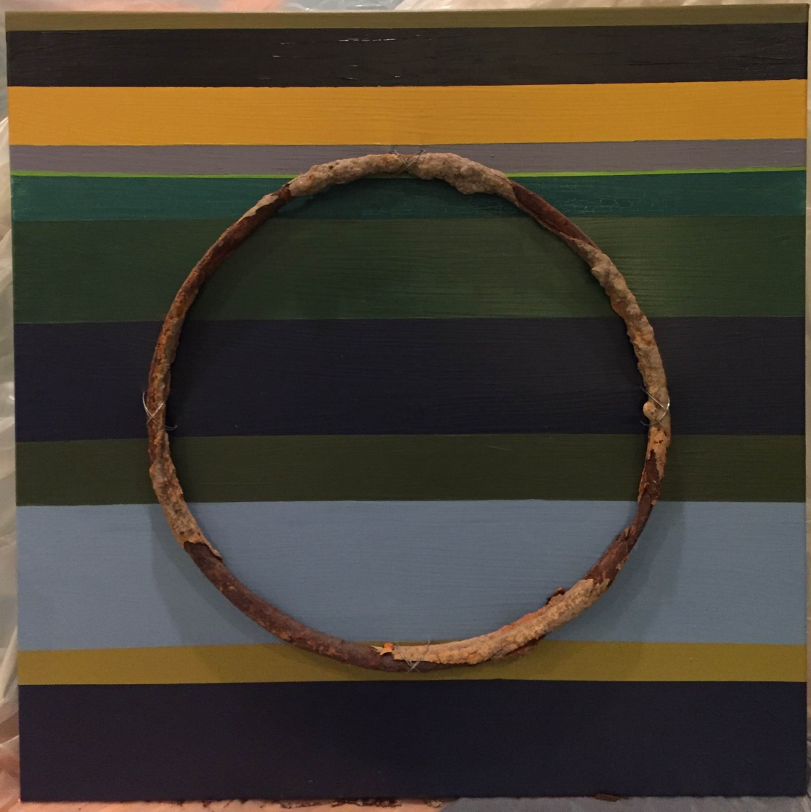
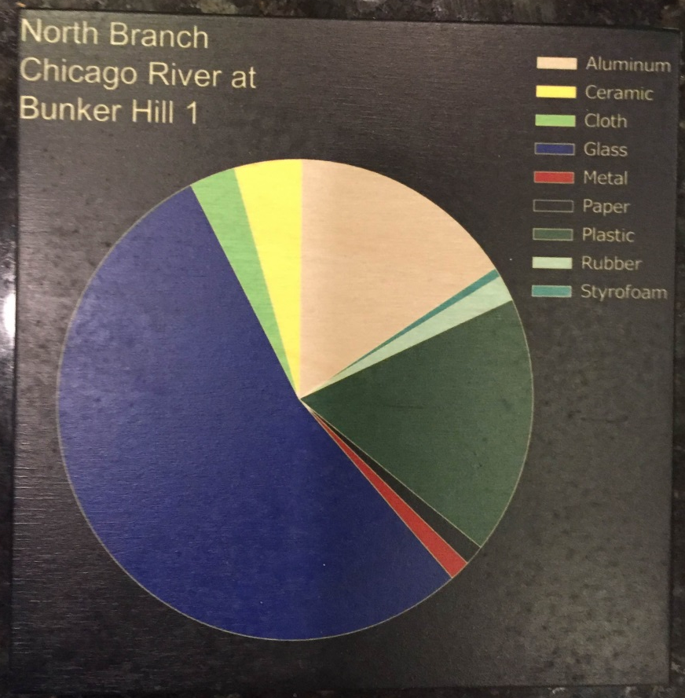
Title card and graphs, ink on wood (6 in x 6 in)
Patches of nature in the urban landscape can offer a surprisingly immersive experience. In one direction a visitor can see the noise and traffic of city life, while in the opposite position the pace and sounds of nature are sustained. This contrast is reflected in the geometric contrast of circle and square, and in the colors I used to refer to the layers that represent geologic strata. The lower green and blue layers refer to the river, while the gray, brown, black, and green at the top are a reference to the city’s buildings, pavement, rooftops, and parks. The placement of the circle throughout the layers conveys the entrainment of humanity’s footprint in Earth’s geologic record, where natural and anthropogenic factors act in concert to transform the material. The graph references the simple geometric contrast in the shape of the pie graph, and illustrates the type of material found at this site. This metal ring is one of those items making up the red section of the graph.

Slide 7
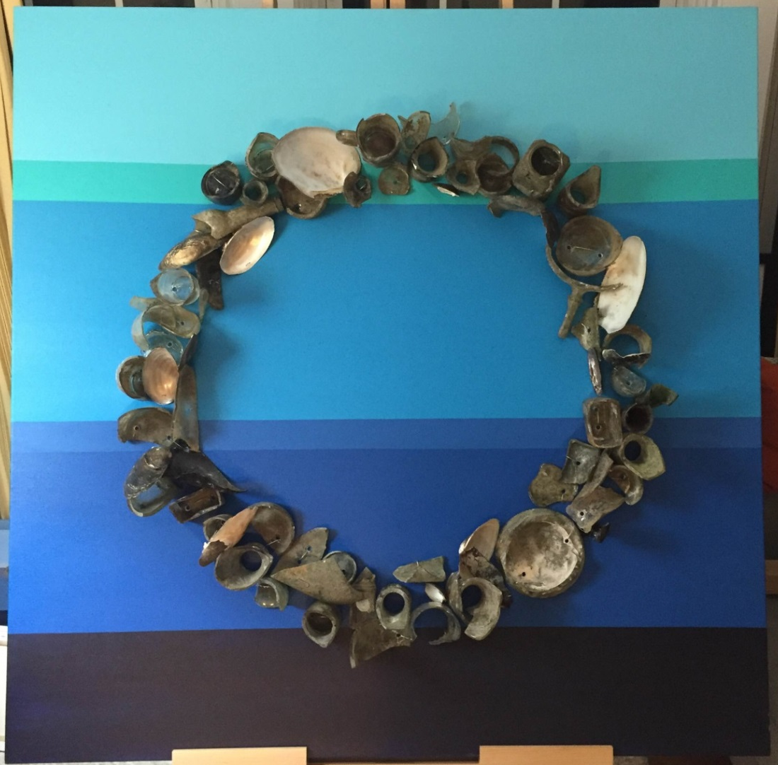
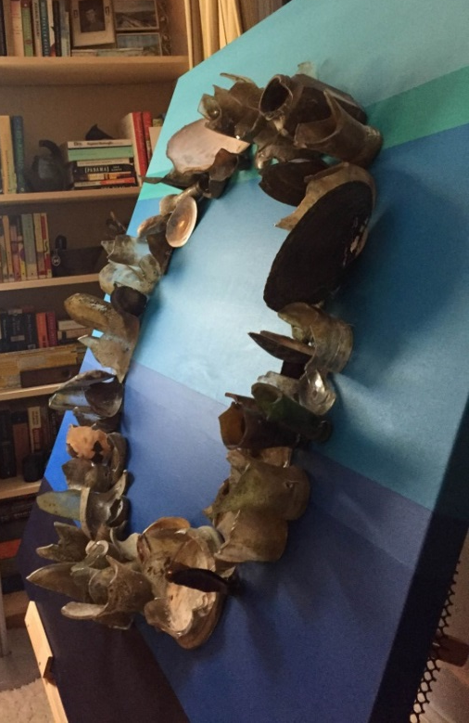
Title card and graphs, ink on wood (6 in x 6 in;
Not yet printed)
Side view to illustrate relief
Acrylic on canvas, with glass and shells from freshwater mussels (Unionidae) attached with steel wire (4 ft x 4 ft)
This piece pairs broken glass and shells of freshwater mussels in a circle, where each item is wired onto a canvas that depicts horizontal layers in peaceful blue tones. The glass and layers refer to the lasting impact of litter on Earth’s sedimentary rock layers. The freshwater mussels are included because they were once highly abundant in North American rivers, but are now among the most endangered groups of animals on Earth. They can be quite large (note the white heelsplitter shells at 11:30 and 2 o’clock), long-lived (up to 50 years), and have unique larval stages where they are parasites on fish gills. Mussels are imperiled because of pollution, fragmentation of river segments (i.e., dams), fishing (they were over-harvested and used to make pearl buttons), and competition from invasive mussels. Three species are represented in the canvas – white heelsplitter, giant floater, and paper pondshell. The low number of shells relative to glass is a reference to declining mussel populations with increasing human impact. The iridescent surface of the mussel shells also gives a nice contrast to the dirty, sharp pieces of broken glass. The graph documents two components of human impact in the river. The data show abundance of trash (anthropogenic litter) in the North Branch Chicago River compared to natural materials like wood and leaf litter, and the abundance of invasive bivalves (asian clam and zebra mussel) relative to native freshwater mussels.

Slide 8
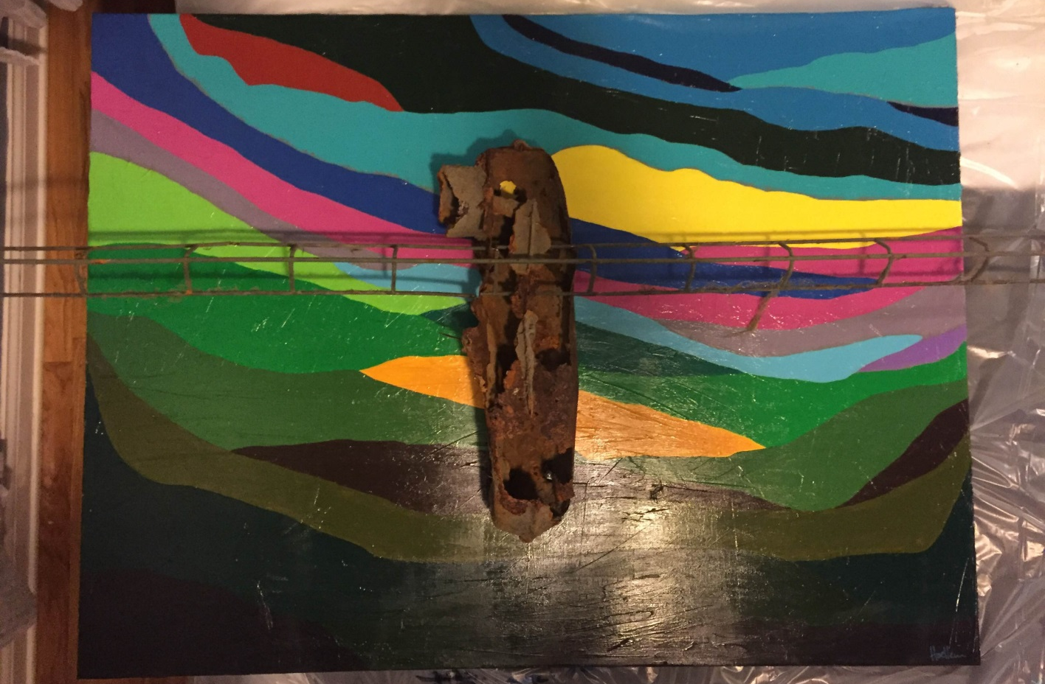
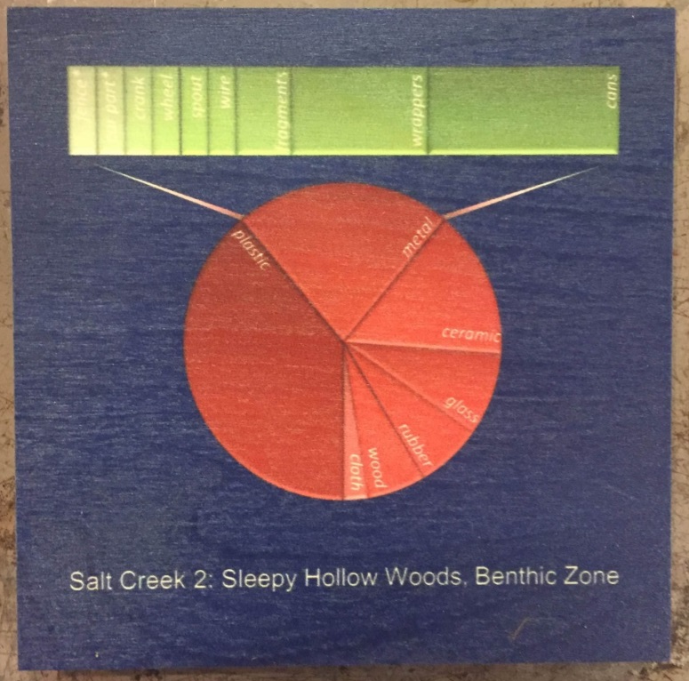
Title card and graphs, ink on wood (6 in x 6 in)
Acrylic on canvas, with attached metal sculpture (3 ft x 4 ft)
When collecting litter during our surveys, I am often struck by the spontaneous shapes the piles of garbage can take on. Its similar to seeing animals in clouds. I saw this ‘dragonfly’ in the pile and kept the items together for this sculpture. I allude to geologic deposition and long-term record of humanity’s impact in Earths soil and rock layers using horizontal strata. In addition, I illustrate the unintentional beauty wrought by rust, mud, time, and slime. Litter items face inevitable transformation in the river and the decomposition brings a rebirth. Similarly, dragonflies are aquatic as larvae, and then transform into winged, terrestrial adults. I show this spirit as a dragonfly moving across an abstract green landscape into the sky. The notion of flight is reinforced by extending the wings beyond the edge of the canvas, as well as the 3-dimensionality of the dragonfly’s body.
The graph is a relatively simple summary the types of litter we found at this site. I’ve extended one slice of the pie graph into a bar to illustrate the sub-categories of material in the metal category. This is a common presentation in science, and its use always recalls to me the general shape of a bird or flying insect. I’ve exaggerated that design here. Its my hope the viewer notes that scientists’ choices for data presentation are those of a graphic artist. The shapes of graphs, as well as their content, are critical for successful conveyance of information.

Slide 9
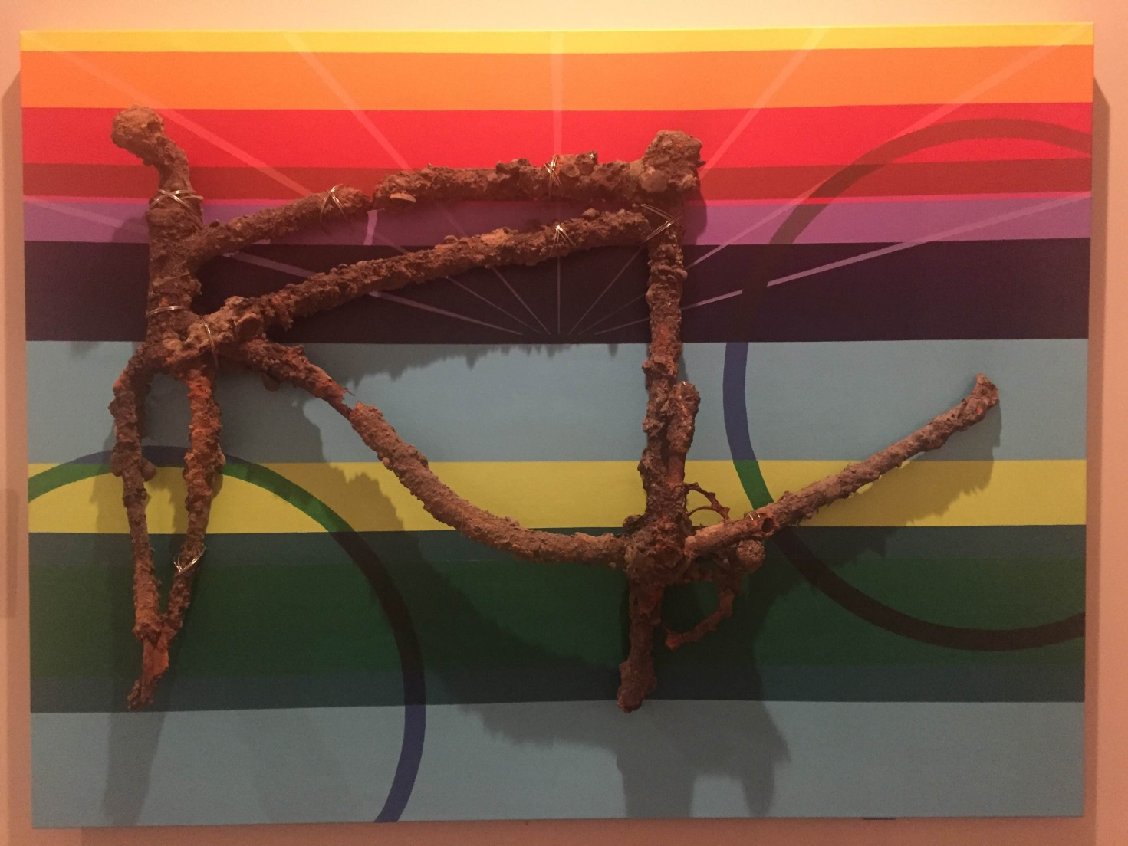
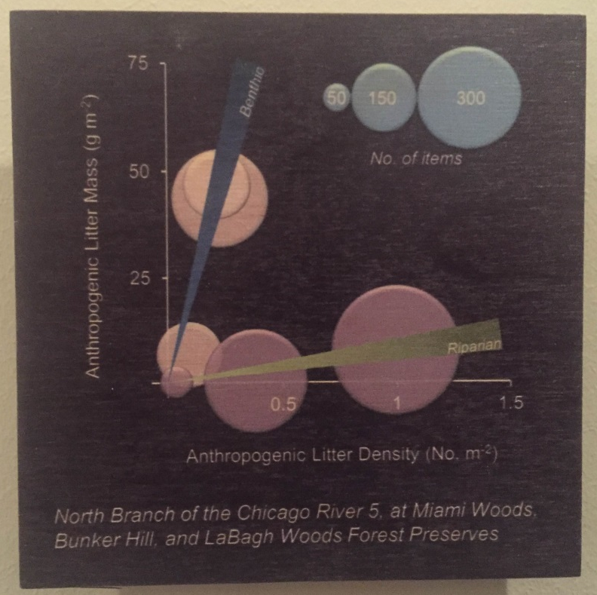
Title card and graphs, ink on wood (6 in x 6 in)
Acrylic on canvas, with attached metal sculpture (3 ft x 4 ft)
This metal bike frame is a good example of how litter changes while it slowly reverts back to its component pieces. This bike is old, and has likely been in the river for many years. Many things are attached to it: large pebbles, bits of what appear to be coal, and zebra mussels. I placed the bike frame on a field of horizontal layers, referencing the time elapsed since its become a part of the river. I ‘re-animated’ the bike with colors and visual cues that emphasize movement on the canvas. The colors and sunburst lines are a reference to sunrise over a body of water. The wheels are painted in to show the bike is oriented at an angle, such that it is leaping towards the water surface. Perhaps the way it got to the river was a leap of joy, rather than someone throwing it away? The graph shows the relationship between litter abundance and density in the North Branch of the Chicago River. We find many more items in the riparian zone (streamside vegetation) than in the benthic zone (streambed). However, the items in the riparian zone tend to be light, while the items in the benthic zone are generally heavy. This bike frame is a good example of heavy items found in the benthic zone. The circles and lines reference the shapes of the bike wheels and sunburst in the painting.

Slide 10
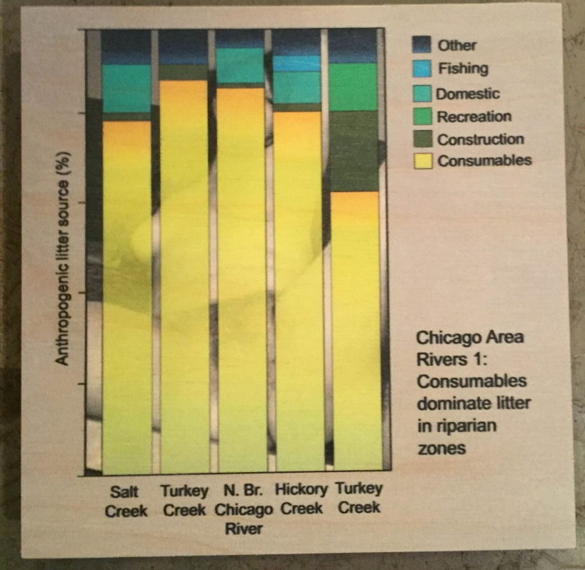
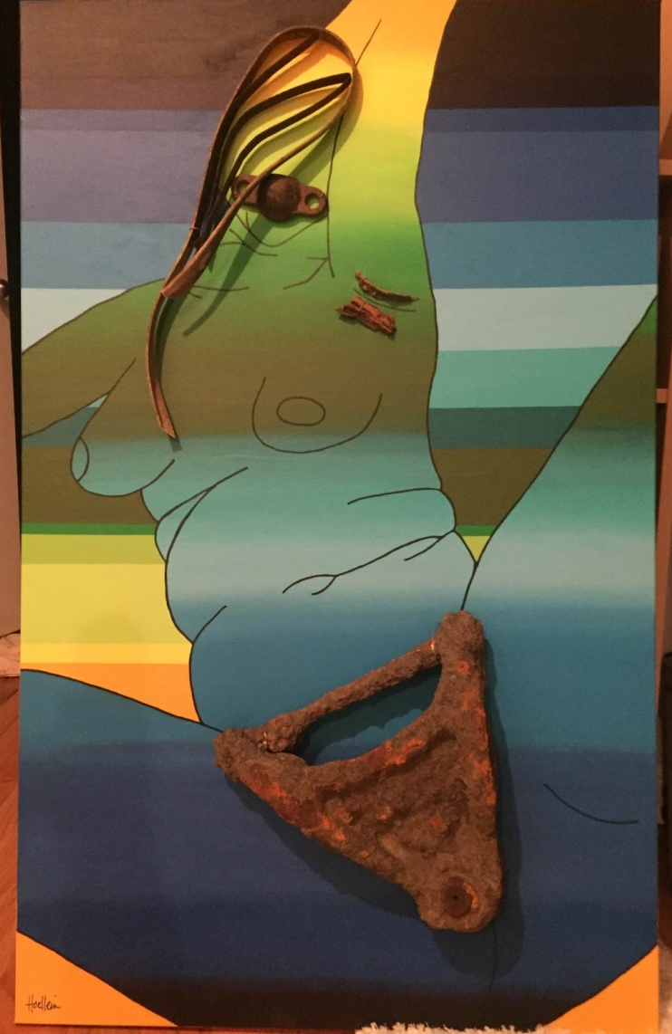
Title card and graphs, ink on wood (6 in x 6 in)
Acrylic on canvas, with attached metal and rubber (2.5 ft x 4 ft)
This piece is about consumption. Our research shows most litter we find in the rivers and on Lake Michigan beaches is categorized as ‘consumables.’ This is illustrated for 5 rivers in the graph. The category includes bottles, cigarettes, styrofoam containers, and other items generated from eating, smoking, and drinking. The act of consumption itself last minutes, but the remnants last for many years. The idea for this painting struck me when I heard a popular radio commentator refer to viewing internet pornography as ‘consumption’, rather than as ‘viewing’ or ‘watching’. I hadn't thought of it before, but I wondered if there was a similarity between our conspicuous consumption and careless disposal of material goods, and our culture’s pornography appetite? Each activity leaves a mark on the individual and the larger culture, and is rooted in the immediate settling of basic desires with little regard for long-term ramifications for the discarded subjects. I painted an abstraction of a pornographic image from the internet. I used the motif of horizontal layers (geologic strata), metal and rubber to illustrate hair and lips, and reversed the order of colors in the body relative to background. The image conveys lust and anonymity. I used an edited version of the internet picture for the graph background, and reinforced her anonymity by hiding most of the image behind the data. The term ‘consumption’ was the link - the resulting artwork shows an unexpected connection about our desire for temporary satiation of all kinds.

Slide 11
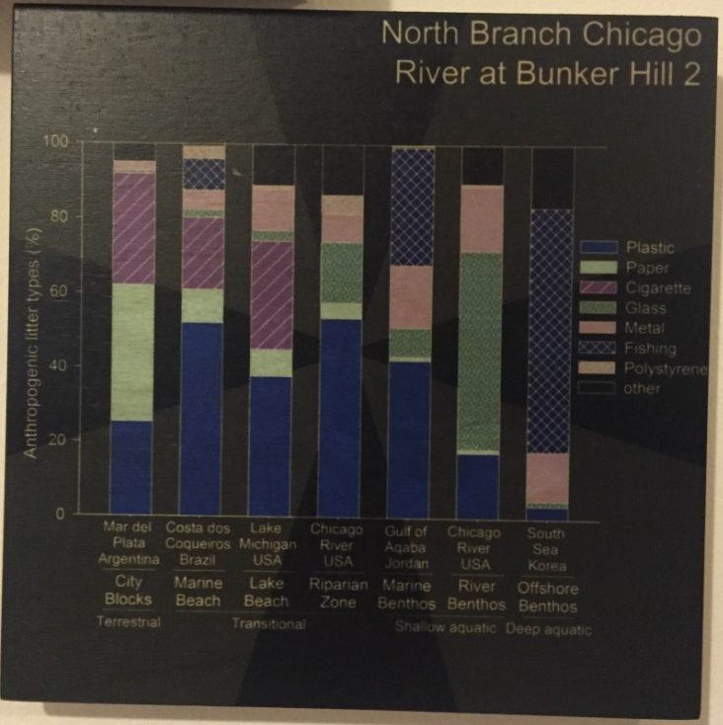
Acrylic on canvas, with attached wood and glass (3 ft x 1 ft)
The piece is a statement regarding the amount of glass we find in river benthic zones (streambed). We find a lot! Much of it is in pieces. The graph shows that compared to other types of aquatic ecosystems, glass in the river is very abundant (green panel in the bar second from right). Reasons for this are the continuous breaking of glass as it is periodically moved downstream, and the shattering that follows freeze/thaw cycles. I wanted to illustrate the breaking of the glass by showing a ‘burst’ of glass items as it hits a piece of wood. The wood and glass are from the Chicago River. The bursting is reinforced by a sunburst pattern of the navy blue in alternating matte and gloss finishes.
Title card and graphs, ink on wood (6 in x 6 in)

Slide 12
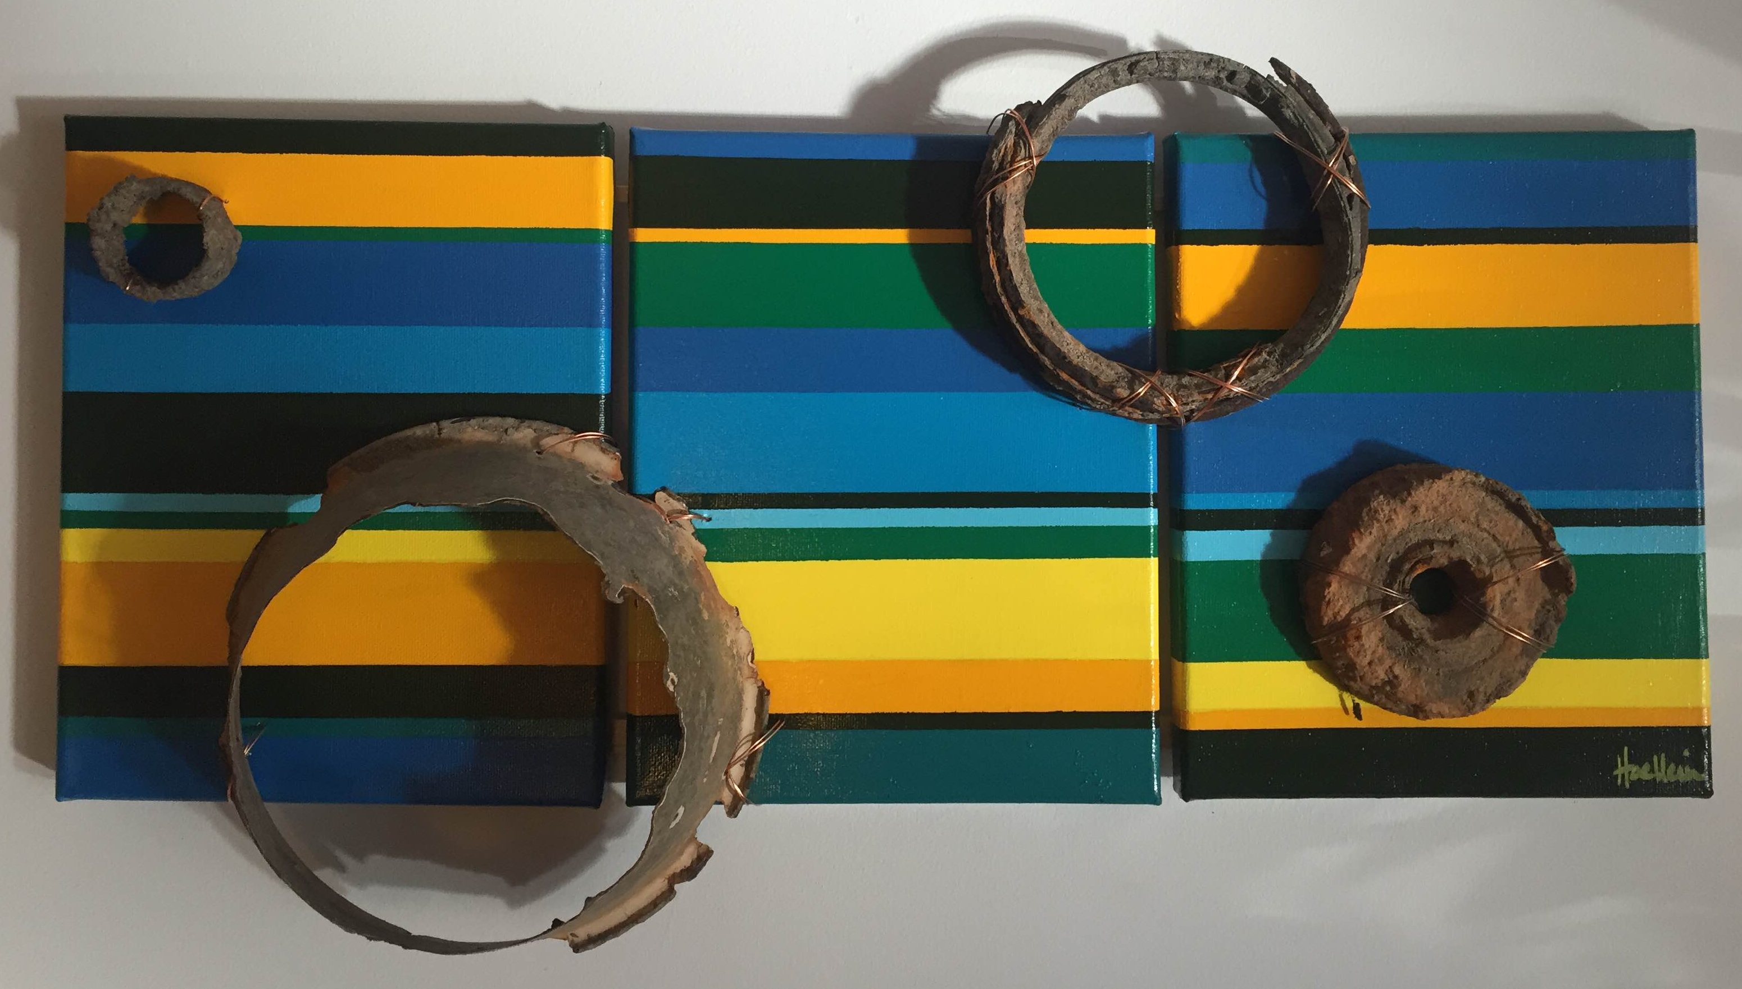
Tryptic: acrylic on canvas, with attached metal and wire sculpture (3 ft x 1 ft)
The piece is about burial. The geologic strata are the same size and order in each of the 3 panels. Moving left to right, the colors shift down one spot. The result is an ‘animation’ of the slow process of burial. The rings are attached with copper wire, and refer to the entrainment of our litter into the permanent record.

Slide 13
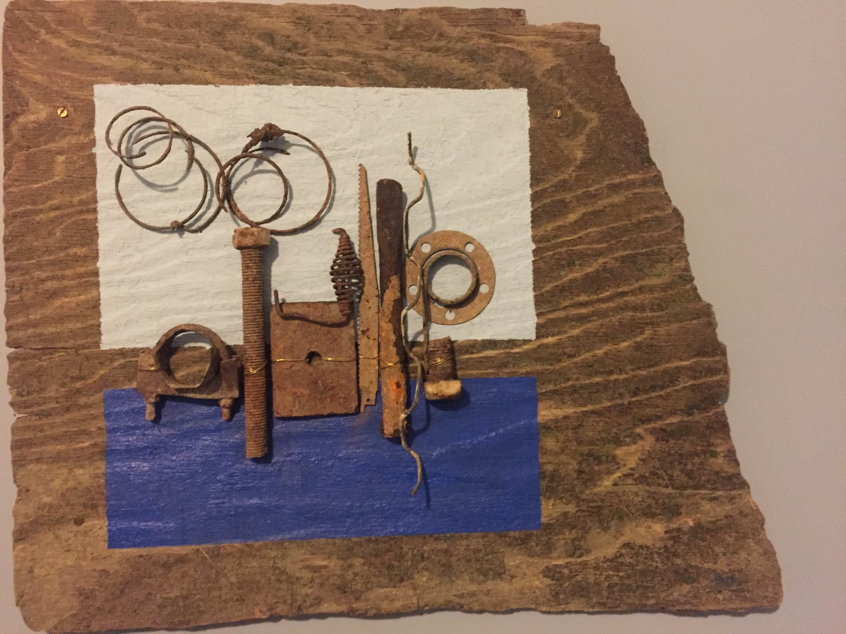
Acrylic on plywood, with attached metal sculpture (2 ft x 2.5 ft)
The piece is an abstraction of a cityscape on a weathered piece of plywood from Hickory Creek (Joliet, IL). Many of the small metal pieces we find in rivers are from building and construction debris, including screws, fencing, tools, hinges, bricks, and springs. I arranged some of these items on a field of blue blocks to suggest a cityscape on the edge of an aquatic ecosystem (like Chicago). I left much of the edges of the plywood canvas blank to emphasize the beauty of the wood grain, the delicate patches of alae, and the textured surfaces that are achieved by the weathering of the material in the river. I also appreciate how the wood texture is accentuated by its shape under the blue paint.

Slide 14
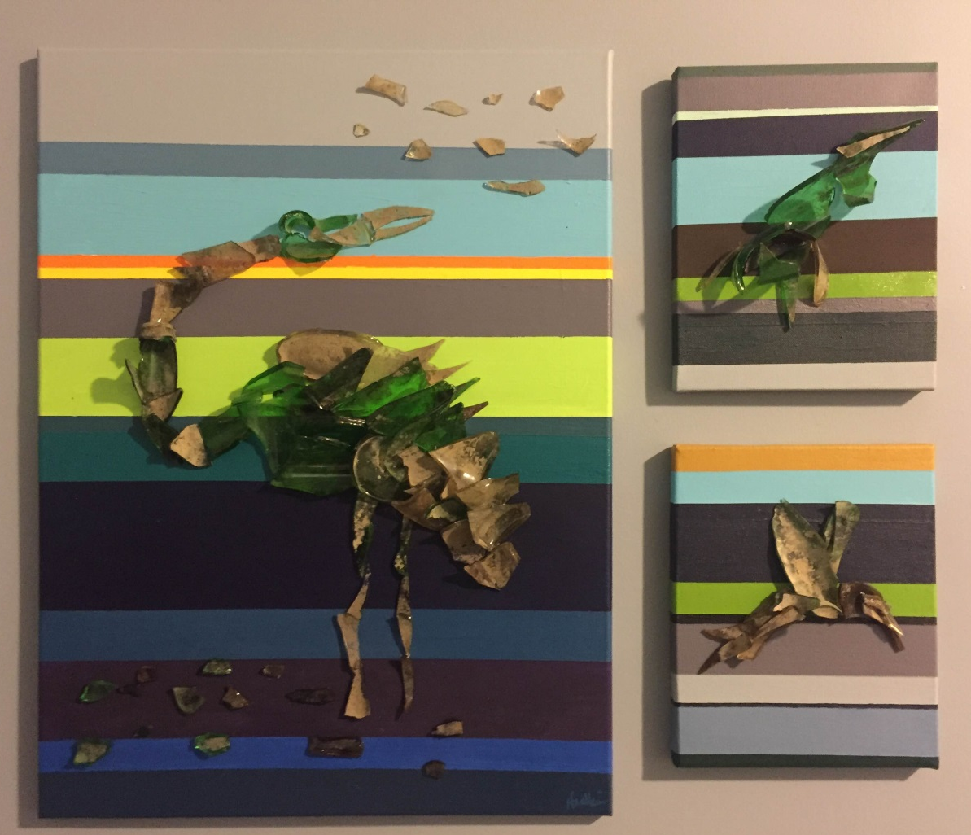
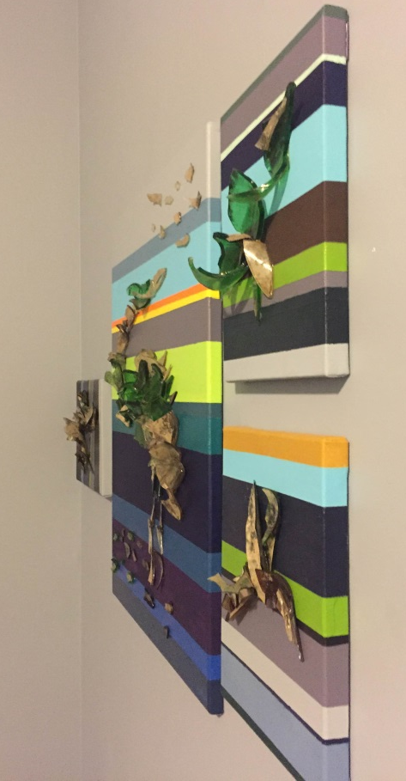
Side view to illustrate relief of glass
Tryptic: acrylic on canvas, with glass and epoxy (2.5 ft x 2.5 ft)
Abstracts of birds crafted from broken glass are shown in these pieces. The bird on the left and the upper right are water birds, a great blue heron and a green heron, respectively. The bird on the lower right is an abstract starling. These are common sites in urban rivers, where they are successful despite decades of pollution and human modification. The horizontal stripes are an allusion to the long-term impact of humanity on Earth’s geologic record, of which garbage like plastic and glass are a marker. I positioned the large heron standing in stripes colored to reference water, with it turned to look up at the sky, shown in blue and grey. The colors of the stripes on the other 2 pieces are in reference to the aquatic and built environment of the Chicago River.

